Slide 1
Welcome!
Sunday
Bible Study 9:30 AM
Worship 10:30 AM
Wednesday
Bible Class 7:00 PM
www.SunsetchurchofChrist.net

Slide 2
John 8:21-30
Jesus reveals His goal
Belief in Jesus
Speaking from the Father

Slide 3
Welcome!
Sunday
Bible Study 9:30 AM
Worship 10:30 AM
Wednesday
Bible Class 7:00 PM
www.SunsetchurchofChrist.net

Slide 4
Opening Prayer | Terry Petsche
Song – | Grant Haines
Scripture Reading | Anthony Ward
Song – | Grant Haines
Song – | Grant Haines
Lord’s Supper | Anthony Ward / Brian Haines
Song – | Grant Haines
Collection | Anthony Ward / Brian Haines
Song – | Grant Haines
Lesson | Brian Haines
Song – | Grant Haines
Closing | Lamar McDonald

Slide 5
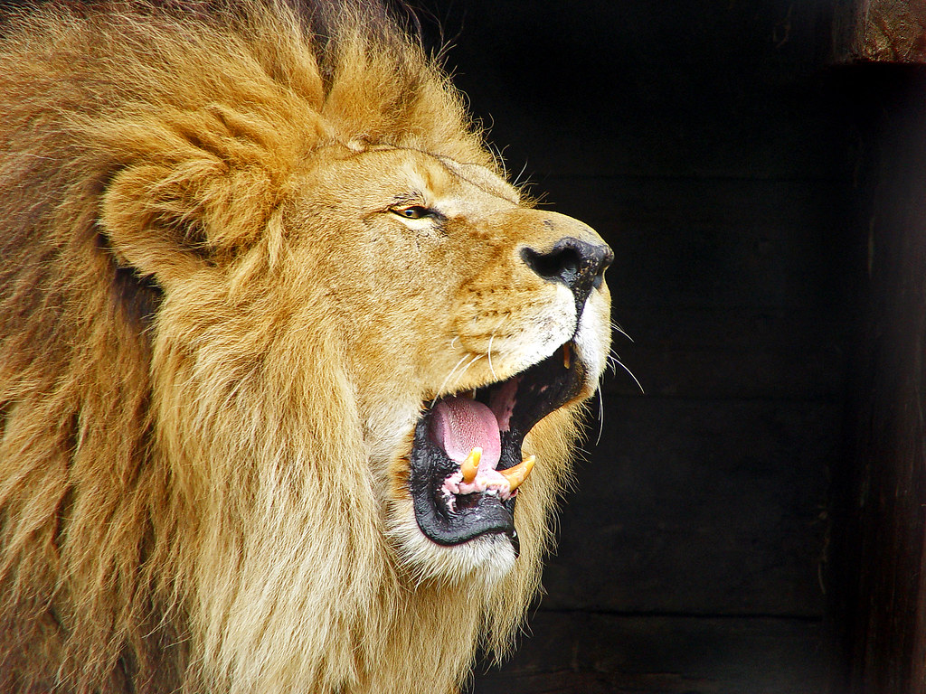
1 Peter 5:8 Be sober, be vigilant; because your adversary the devil walks about like a roaring lion, seeking whom he may devour

Slide 6
Our Adversary
Lest Satan should take advantage of us; for we are not ignorant of his devices. 2 Corinthians 2:11
We are told of his means of action
We need to prepare ourselves
Notes:
Feminism: the belief in social, economic, and political equality of the sexes

Slide 7
Our Adversary
Lest Satan should take advantage of us; for we are not ignorant of his devices. 2 Corinthians 2:11
Submit therefore to God. Resist the devil and he will flee from you. James 4:7
Notes:
Feminism: the belief in social, economic, and political equality of the sexes

Slide 8
Four Common Tools
Coming at our weakest times
Using doubt
Filling up our time
His big lies
Notes:
Feminism: the belief in social, economic, and political equality of the sexes

Slide 9
Our Weak Moments
When we are new
Mark 4:16-17
When we are hurting
Matthew 4:2-3
When we are proud
2 Corinthians 12:7
Notes:
Mr 4:16 "These likewise are the ones sown on stony ground who, when they hear the word, immediately receive it with gladness; 17 "and they have no root in themselves, and so endure only for a time. Afterward, when tribulation or persecution arises for the word's sake, immediately they stumble.
Mt 4:2 And when He had fasted forty days and forty nights, afterward He was hungry. 3 Now when the tempter came to Him, he said, "If You are the Son of God, command that these stones become bread.“
2Co 12:7 And lest I should be exalted above measure by the abundance of the revelations, a thorn in the flesh was given to me, a messenger of Satan to buffet me, lest I be exalted above measure.

Slide 10
Doubt
Doubting our confidence in Christ
Peter’s denial of Jesus – Luke 22:31
Doubting our forgiveness in Christ
Judas’ suicide – Matthew 27:5
Notes:
Lu 22:31 And the Lord said, "Simon, Simon! Indeed, Satan has asked for you, that he may sift you as wheat.

Slide 11
Filling Our Time
Too much to do
Luke 14:18-20
Too many recreations
Luke 16:19
World of distractions
Luke 10:40
Notes:
Lu 14:18 "But they all with one accord began to make excuses. The first said to him, 'I have bought a piece of ground, and I must go and see it. I ask you to have me excused.‘ 19 "And another said, 'I have bought five yoke of oxen, and I am going to test them. I ask you to have me excused.‘ 20 "Still another said, 'I have married a wife, and therefore I cannot come
Lu 16:19 ¶ "There was a certain rich man who was clothed in purple and fine linen and fared sumptuously every day.
Lu 10:40 But Martha was distracted with all her preparations; and she came up to Him and said, "Lord, do You not care that my sister has left me to do all the serving alone? Then tell her to help me."

Slide 12
The Big Lies
A form of godliness
2 Corinthians 11:14
Good enough
James 2:11-12
Time enough later
Luke 12:16-19
Notes:
2Co 11:14 No wonder, for even Satan disguises himself as an angel of light.
Jas 2:11 For He who said, "Do not commit adultery," also said, "Do not murder." Now if you do not commit adultery, but you do murder, you have become a transgressor of the law.
Lu 12:16 Then He spoke a parable to them, saying: "The ground of a certain rich man yielded plentifully.
17 "And he thought within himself, saying, 'What shall I do, since I have no room to store my crops?'
18 "So he said, 'I will do this: I will pull down my barns and build greater, and there I will store all my crops and my goods. 19 'And I will say to my soul, "Soul, you have many goods laid up for many years; take your ease; eat, drink, and be merry."'20 "But God said to him, 'Fool! This night your soul will be required of you; then whose will those things be which you have provided?'

Slide 13
Know Your Enemy
He uses many schemes
We can be prepared
Resisting him works

Slide 15
Redeem the Time
What if today was your last day?
Will you go to heaven with Jesus?
What needs to be said?
What need to be done?
Notes:
Mt 7:6 "Do not give what is holy to the dogs; nor cast your pearls before swine, lest they trample them under their feet, and turn and tear you in pieces.
Col 4:6 Let your speech always be with grace, seasoned with salt, that you may know how you ought to answer each one.

